Slide 1
AIML Lab 02
Done by Darius (p2222259)

Slide 2

01
Creating algorithm

Slide 3
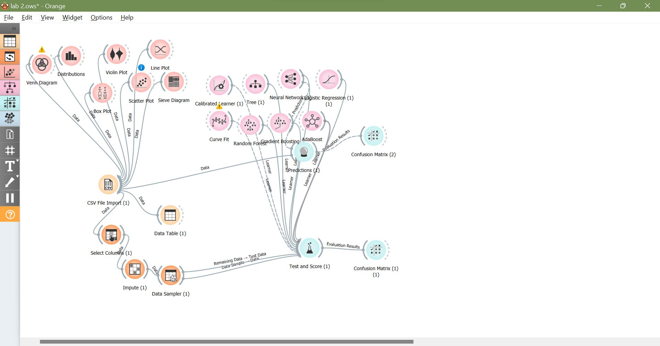
What I did

Slide 4
As seen above
• Firstly I loaded in my data and check it by looking at the data table and different methods of visualisation.
• Secondly I selected the rows that I think affect the survivability while ignoring those that aren’t important.
I then impute it to fill in missing data and put it
through a data sampler to get it ready for
predictions

Slide 5
As seen above
•After all that preparation is ready I linked the remaining data to be used as test data allowing me to check the effectiveness of the algorithm.
• Then I place multiple different model to predict to see which is the most effective and linking all those the test and scores widget to check the
result.

Slide 6
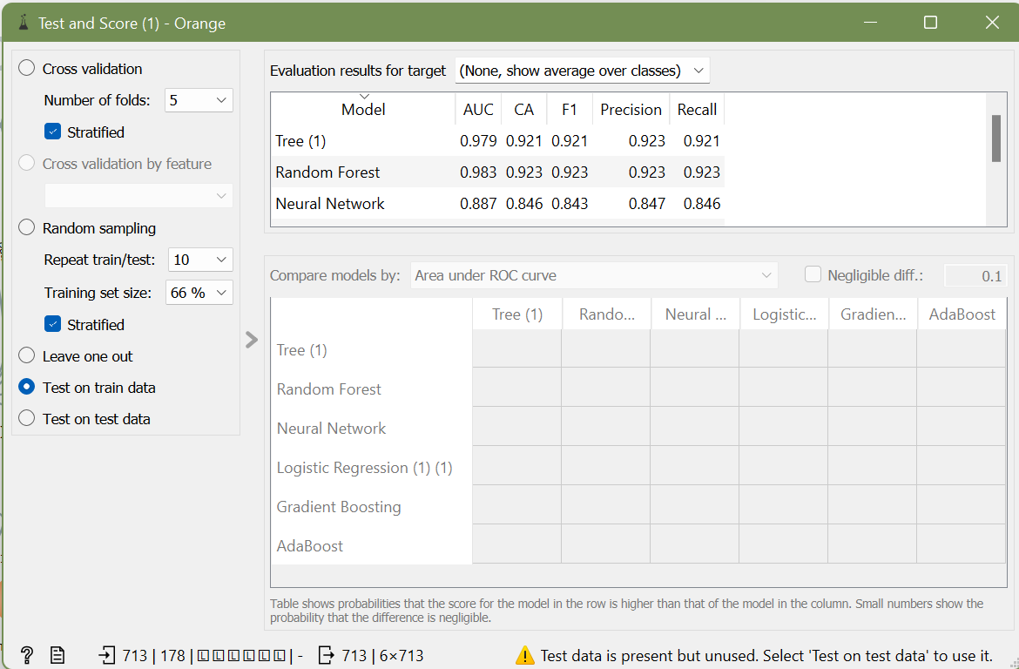
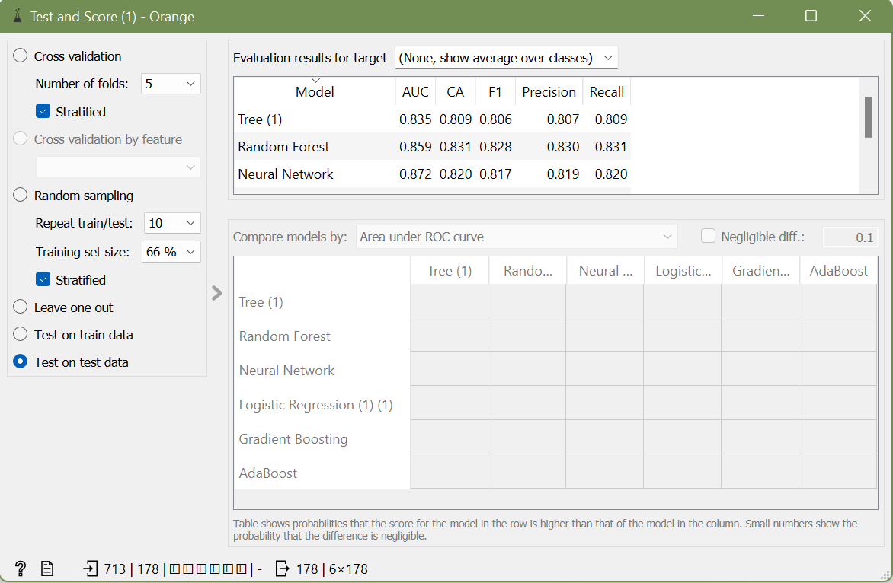
Results

Slide 7
As seen above
When looking at the different results I decided to look at the F1 score as I think it is the best way to look at prediction accuracy in this case.
And found out that Neural Network is the most efficient model used to predict as first it has quite a high value of precision and while
comparing the test and train result it has the
least difference between the 2 showing

Slide 8
Thanks!
Do you have any questions?
Please keep this slide for attribution

